Slide 1
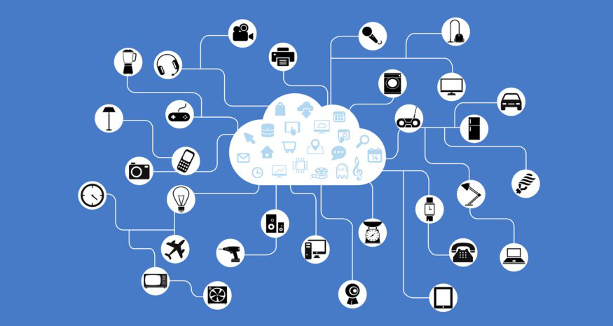

TRIDENT
Threat Recognition and Intelligent Defense in IoT Networks

Slide 2
A project by NetNonsene: Umair Ahmed --- 24377
Huzaifa Bin Tariq --- 25133
Saira Batool --- 25182
Sameed Khatri --- 25249

Slide 3





The IoT ecosystem: Communication Dynamics
Subscribed to :"new"
Published :"data"
Publish :"data"
MQTT Server
Subscribers
Topic :"new"
Published :"data"
Broker
Publisher
Subscribed to :"new"

Slide 4


TRIDENT FRAMEWORK
EXTRACT INFORMATION
CAPTURE TRAFFIC
AI TRAFFIC ANALYSIS
1
2
3
IoT Traffic
Good Traffic
subscriber
Bad Traffic

Slide 5
TRIDENT SYBOLISM : THREE PRONGS, THREE TRIADS
ML model for IoT attacks
AI ANALYSIS
Wireshark/tcpdump
PCAP to CSV
TRAFFIC CAPTURE
INFO
EXTRACTION

Slide 6
HOW TRIDENT WORKS : A guard at the gate of the subscribers
Wireshark/tcpdump
Keeping an eye on the incoming traffic from the channels sent by the broker to the subscribers.
Sequence/series of packets are monitored in wire shark/tcpdump.
The packets monitored are bundled into a chunk, converted to PCAP files and handed over to the middleware for extraction.
TRAFFIC CAPTURE

Slide 7
HOW TRIDENT WORKS : A guard at the gate of the subscribers
This is where the middleware comes in play.
Middleware extracts the relevant information from the packets in the PCAP file provided.
It then writes all the collected information into a CSV file with relevant headers on which the ML model is trained.
Finally the CSV file is passed onto the ML model for analysis.
PCAP to CSV
INFO
EXTRACTION

Slide 8
HOW TRIDENT WORKS : A guard at the gate of the subscribers
The pre trained ML model analyses the traffic headers and extracted relevant information in the CSV file and classifies it to either a good traffic or a bad traffic.
The good traffic is the one that doesn’t match the patterns and context of IoT attacks traffic on which the model is trained.
The bad traffic is the one that matches the patterns and context of the IoT attacks traffic on which the model is trained.
If it is a good traffic then it is let through to reach the subscriber else it is blocked from reaching to the subscriber.
ML model for IoT attacks
AI ANALYSIS

Slide 9


TRIDENT IN THE ECOSYSTEM : POSEIDON?
Subscriber
Good traffic
Subscribed to :"new"
Published :"data"
Bad traffic
Publish :"data"
MQTT Server
Topic :"new"
Bad traffic
Published :"data"
Broker
Publisher
Subscribed to :"new"
Good traffic
Subscriber

